Slide 1


A Path to Predictive
Developing the infrastructure to deploy AI successfully
Digital Academy: February 21, 2019

Slide 2

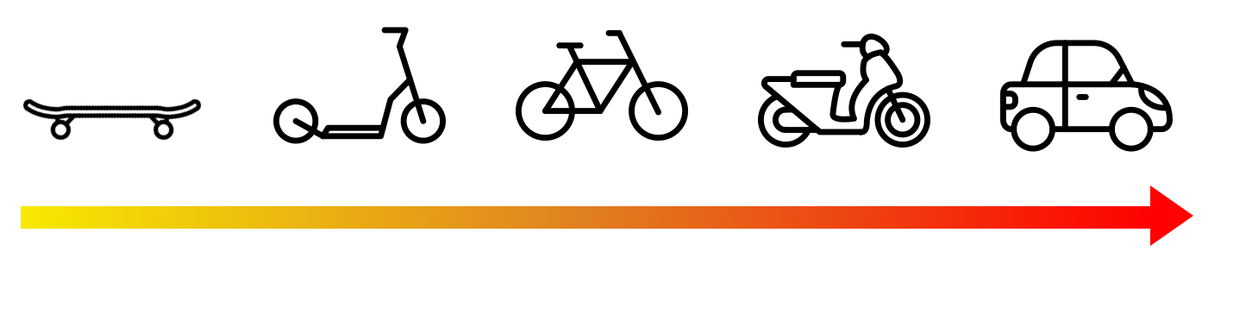
Main Takeaways
The path to predictive depends on a reimagining of how we collect, distribute, and think about data
Collect: moving from manual to automated
Control: shifting towards common standards and practices
Optimize: create better policy by bringing data together from across multiple jurisdictions
Analyze: achieve single-pane view to drive insight
Apply: spot trends in real time, leading to leaner, more efficient processes
Secure, collaborative data management.
http://namara.io/insights/blog/

Slide 3

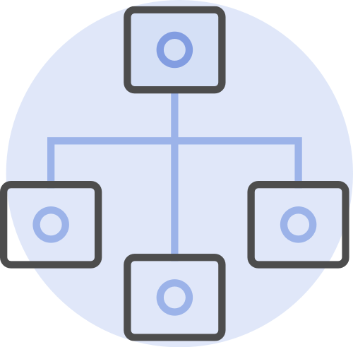
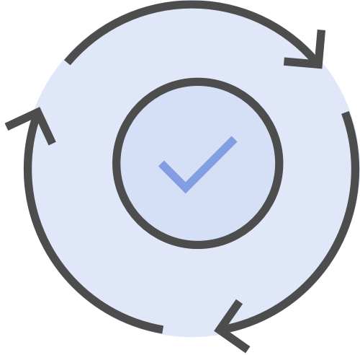

ThinkData Works at a Glance
From our origins in the Open Data movement in Canada, ThinkData Works now manages one of the largest repositories of public data in the world.
Industry-agnostic transformation pipeline
Consistently monitored and updated
API accessible and seamless integration with BI
+250K Data Sets from +3500 sources
Secure, collaborative data management.
http://namara.io/insights/blog/

Slide 4
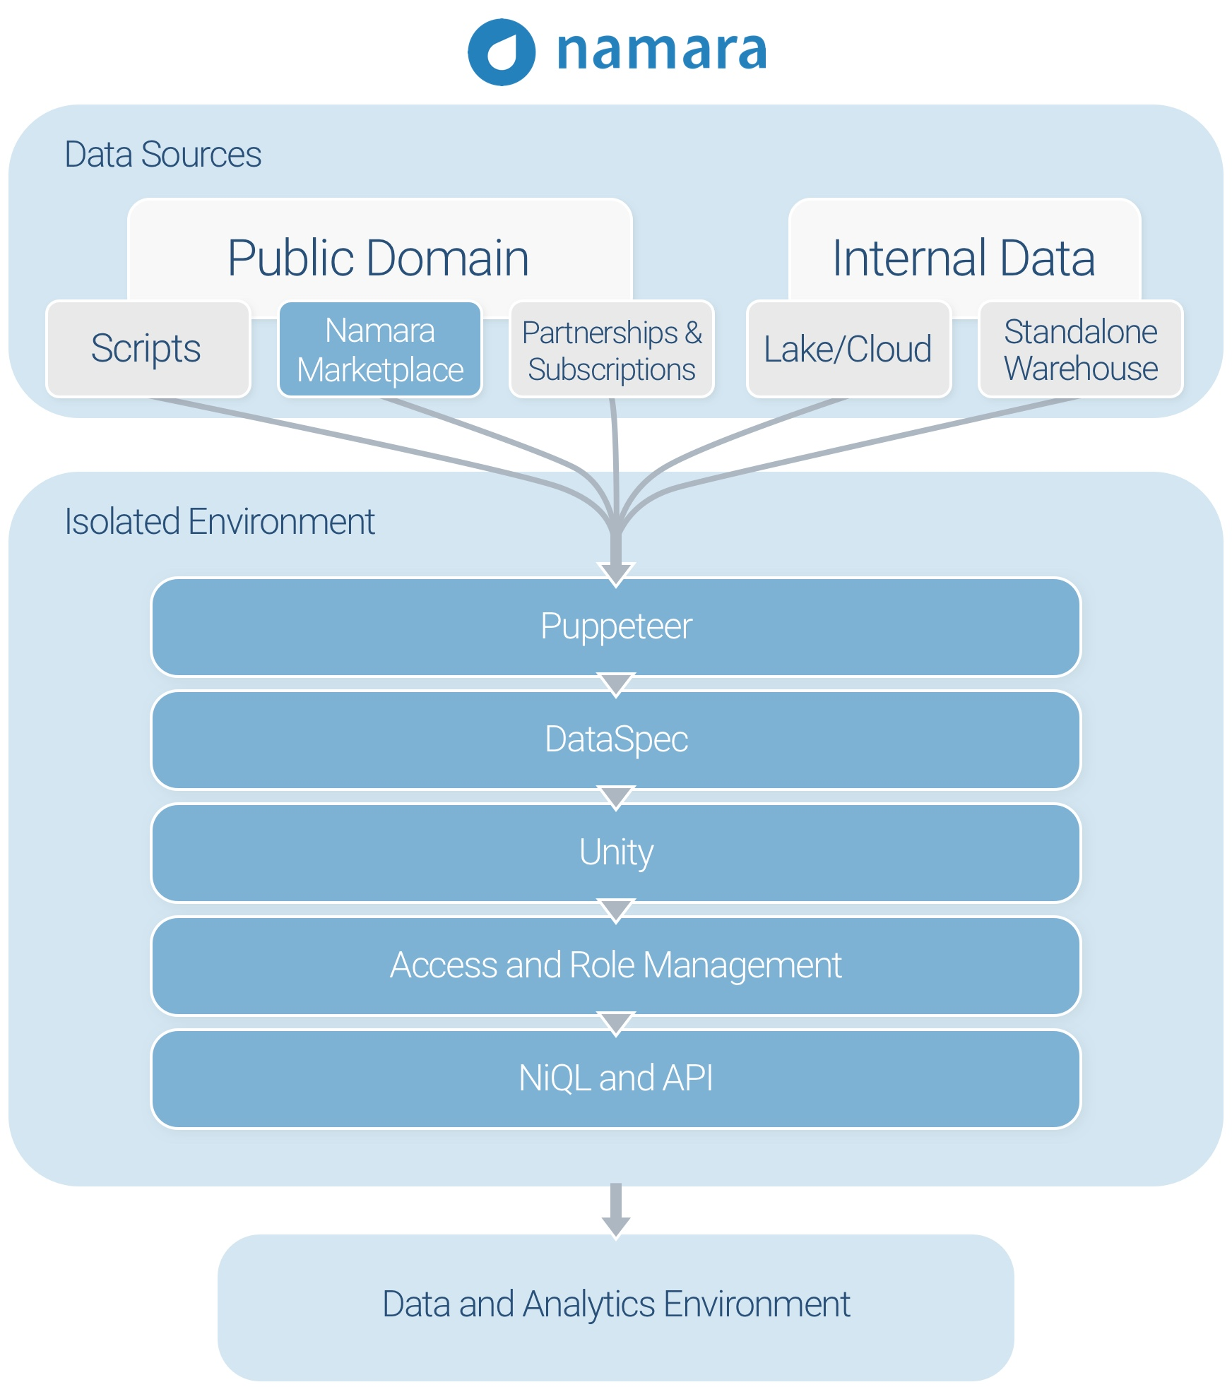
The Problem of Using Data Effectively
For people who connect to data to solve problems, there are a host of difficulties to overcome.
Open data, unstructured public data, third-party data, and internal assets blended in a single, secure, environment
Granular access to every point in the data lifecycle. Monitor, validate, transform, merge, query, and distribute data securely
Integrate with whatever analytics provider or BI solution you need
Secure, collaborative data management.
http://namara.io/insights/blog/

Slide 5

Clerical Tasks are Plaguing Data Scientists
BI and data science teams are getting bigger and more advanced, with the demand for cross-data set analytical projects growing at an exponential rate. But their environments are not keeping up.
Data scientists live in data cleansing and hate it…
80% of time is wasted on finding and cleaning data.
Projects sourcing data from multiple places are stalled.
External data is ignored.
‘DataOps’ support is completely absent.
Data Scientists are leaving or impossible to recruit.
Secure, collaborative data management.
http://namara.io/insights/blog/

Slide 6

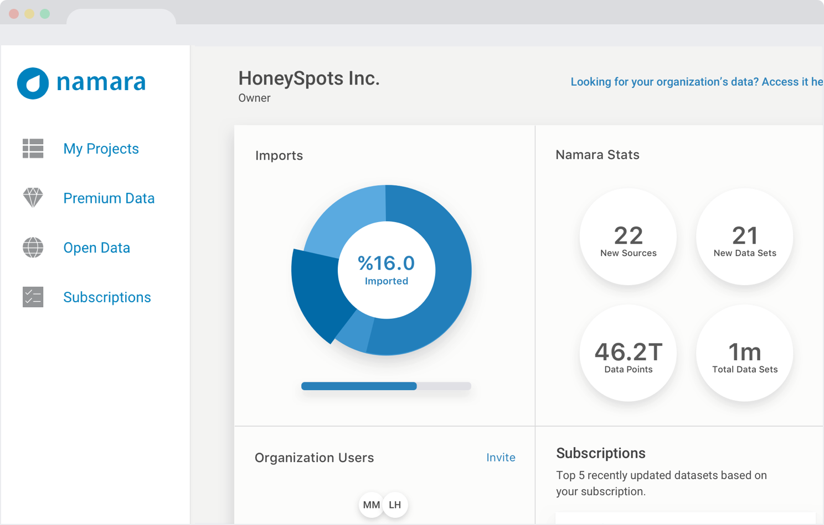
Data Management at Scale
Most organizations will require a collaborative way to access, manage, and integrate with the data that they use to make decisions.
Access new data or add visibility to what you already have.
Enrich and merge data with machine learning and automated data prep.
Collaborate and get better control over the data you use.
Integrate clean data directly into intelligent machines and BI applications.
Monitor data feeds and orchestrate the flow of information.
Secure, collaborative data management.
http://namara.io/insights/blog/

Slide 7

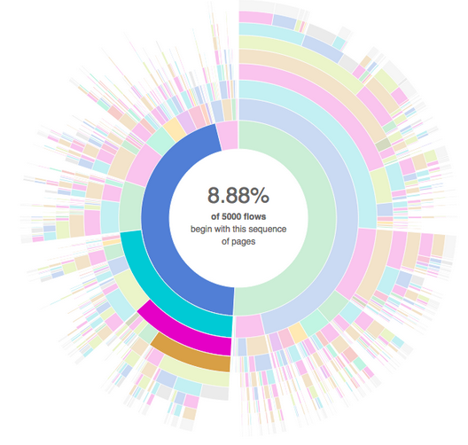

Case Study: TBS CIOB
The Treasury Department of Canada could not drive economies of scale on purchasing due to unwieldly procurement records flowing in from 100+ departments government-wide.
100+
50K
$12B
Procurement data feeds
Annual contracts normalized
Dollars worth of spend analyzed
"The use of various data sets and standards made it virtually impossible to paint a government-wide picture of departmental spending on a vendor by vendor basis. ThinkData solved this by flipping a switch."
- Alex Benay, CIO of the Government of Canada
Secure, collaborative data management.
http://namara.io/insights/blog/

Slide 8
Entity Resolution is a Fundamental Problem in Data Integration
Entity resolution refers to the ability to match multiple data tables together using machine learning techniques in order to identify exact matches and merge information together into master records.
Data source 2
Data Deduplication
Col1 | Col2 | Col3 | ….
Row1
Row2
...
Linking Internal Data
Data source 1
Data source 3
Enriching Internal
with External Data
Col1 | Col2 | Col3 | ….
Row1
Row2
….
Col1 | Col2 | Col3 | ….
Row1
Row2
...
Keeping Track of Unique Entities
Secure, collaborative data management.
http://namara.io/insights/blog/

Slide 9
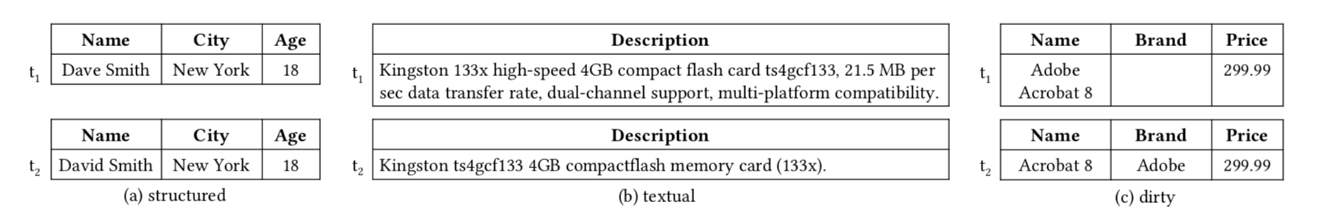
Challenges Facing an Effective and Efficient Solution
There are various algorithmic and design challenges that inhibit the development of effective and efficient entity resolution solutions. Many are plagued by unwieldly compute requirements.
Challenges
Algorithmic
Design
Massive Search Space
Flexible and easy to use
Efficient Comparison Methods
Change accommodation
Structured, textual and dirty data*
Maintaining a master view
Secure, collaborative data management.
http://namara.io/insights/blog/

Slide 10
Benchmarking Against Leading Research
ThinkData has benchmarked resolvER against industry-leading research and is returning comparable accuracy results on structured data and better than average results on dirty data.
resolvER
ThinkData’s best-in-class solution for Entity Resolution.
Developed by ThinkData.
Available to all Namara Enterprise users.
Structured Data Avg: 95% Accuracy
Dirty Data Avg: 93% Accuracy
Magellan
World-leading research Project tackling Entity Resolution.
Developed by UW-Madison.
Sponsored by Facebook, Walmart, InstaCart, and Johnson Control.
Structured Data Avg: 98% Accuracy
Dirty Data Avg: 92% Accuracy
Secure, collaborative data management.
http://namara.io/insights/blog/

Slide 11
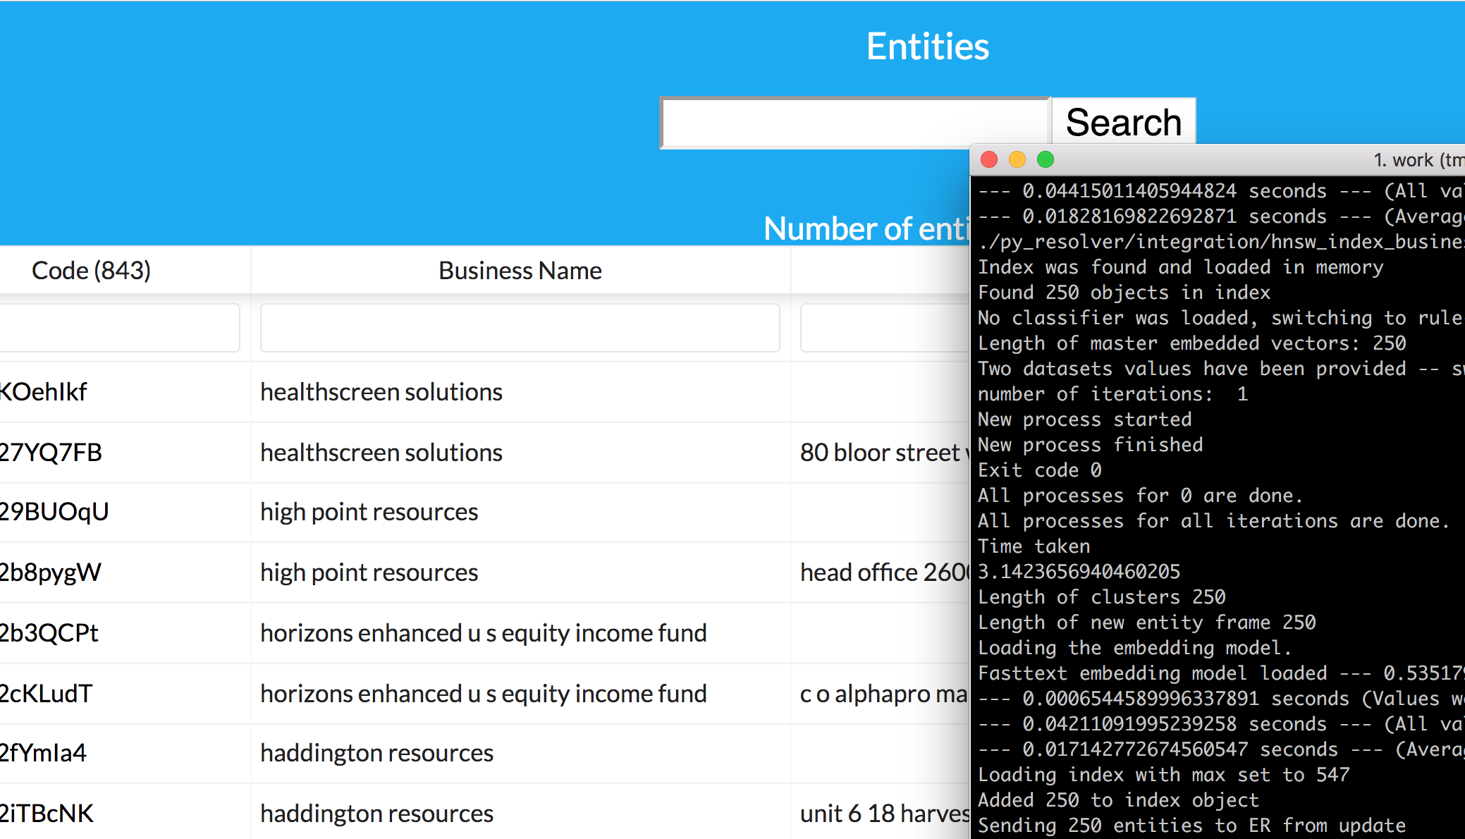
resolvER is a Production-ready ER Solution
resolvER is performing in-line with the most advanced entity resolution research available. It is production ready and deployed within ThinkData enterprise accounts across the world.
Successfully linking various types of data (structured, textual, dirty).
Capable of completing semantic linking.
Industry-leading indexing accuracy leading to high speed turnaround.
Customizable across multiple domains and use cases.
Cloud-enabled for elastic scalability.
Secure, collaborative data management.
http://namara.io/insights/blog/

Slide 12
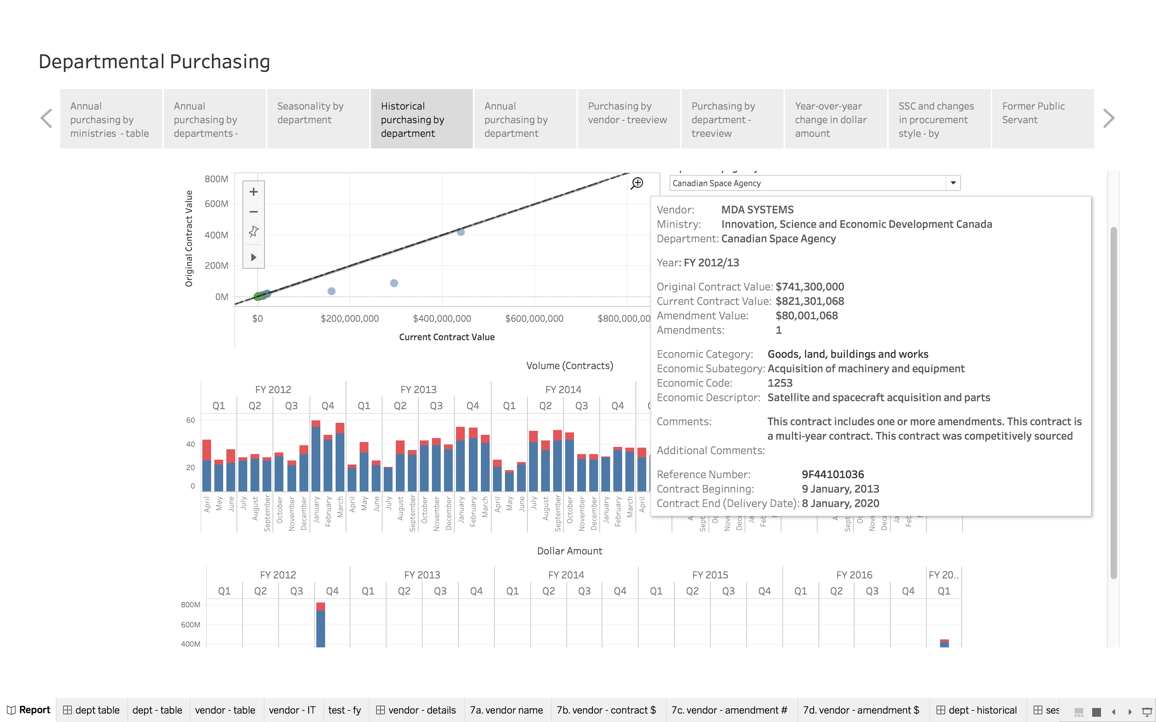




Scale up your AI Capabilities
The path to responsive AI involves reimagining how we generate and use data, but also how we deploy these data products to the people who can use them to make decisions
A Learning Module for the Public Sector
Increase data literacy at every level
Collect and disseminate information quickly
Empower the school of public service to ask questions and have the ability to answer them quickly
Enable policy analysts to make sense of what the system is doing and how it corresponds to strategic goals
Trusted by Canada’s Leaders in AI
Secure, collaborative data management.
http://namara.io/insights/blog/

Slide 13
Contact Us
Toronto HQ
141 Bathurst St.
Toronto, ON M5V 2R2
1(416)456-1446
lewis@thinkdataworks.com
London UK
15 Bishopsgate
London EC2N 3AR
+44 7742 914146
info@thinkdataworks.com

